Slide 1

Enabling corporations to manage change and disruption is mission critical. Workforce evolution is pivotal to business transformation. CIMS Global Technology Solutions can help you get there. Schedule your consultation today at https://bit.ly/343SZaa. #CIMSGlobalTechnologySolutions #CIMSgts #Businesssolutions #businesstransformation #roboticprocessautomation #rpa #businesstobusines #b2b #documentsolutions
Posted 8/18

Slide 2
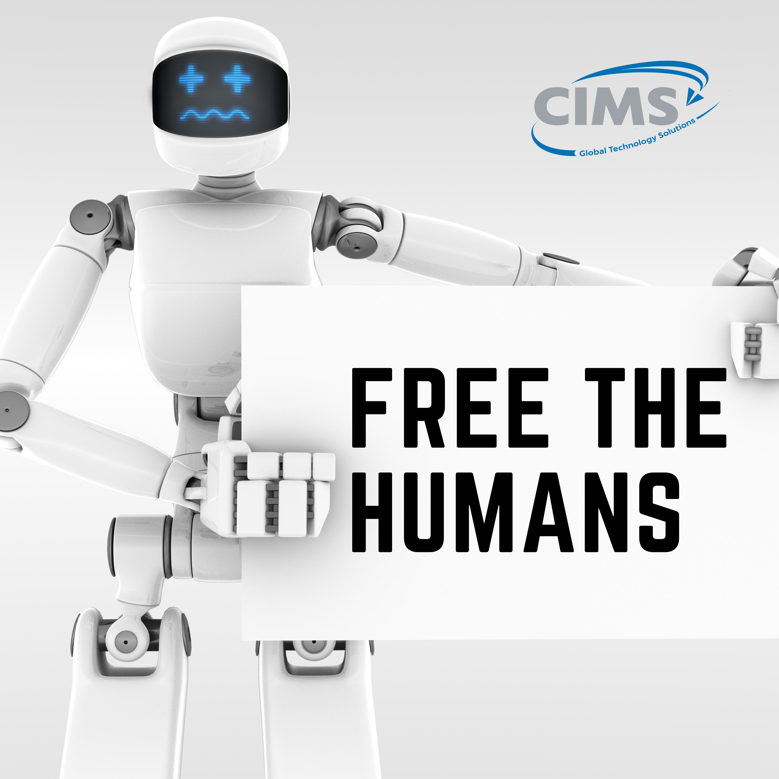
With the help of scalable Robotic Process Automation (RPA) technology, CIMS Global Technology Solutions can help free up your humans to focus on creating, building and innovating. Contact us today and lets get started. https://bit.ly/2CKR0we
#automatedprocessmanagement #robotics #documentsolutions #businesstobusiness #eliminatepaper #wastemanagement #solutions #business #pandemicproof #timemanagement #documentsolutions #businesssolutions #workflowmanagement #databasedevelopment #electronicpublishing #Businesssolutions #businesstransformation #roboticprocessautomation #rpa #businesstobusiness #b2b #bbb #mfiles #kofax #canon #panasonic #kodak #microsoft #Freethehumans #documentmanagement #worksmarter #usableintelligence @RonCasto
Posted 8/20

Slide 3

On-boarding just got easier with Digital Signage. Share agreements and control access to documents with ease. Contact CIMS Global Technology Solutions to schedule a demo today. https://bit.ly/343SZaa #CIMSGlobalTechnologySolutions #CIMSgts #digitalsignage #businesstobusiness #documentsolutions #processautomation #b2bsolutions #EmployeeExperience #technology #automatedprocessmanagement #robotics #documentsolutions #businesstobusiness @RonCasto
Posted 8/25

Slide 4
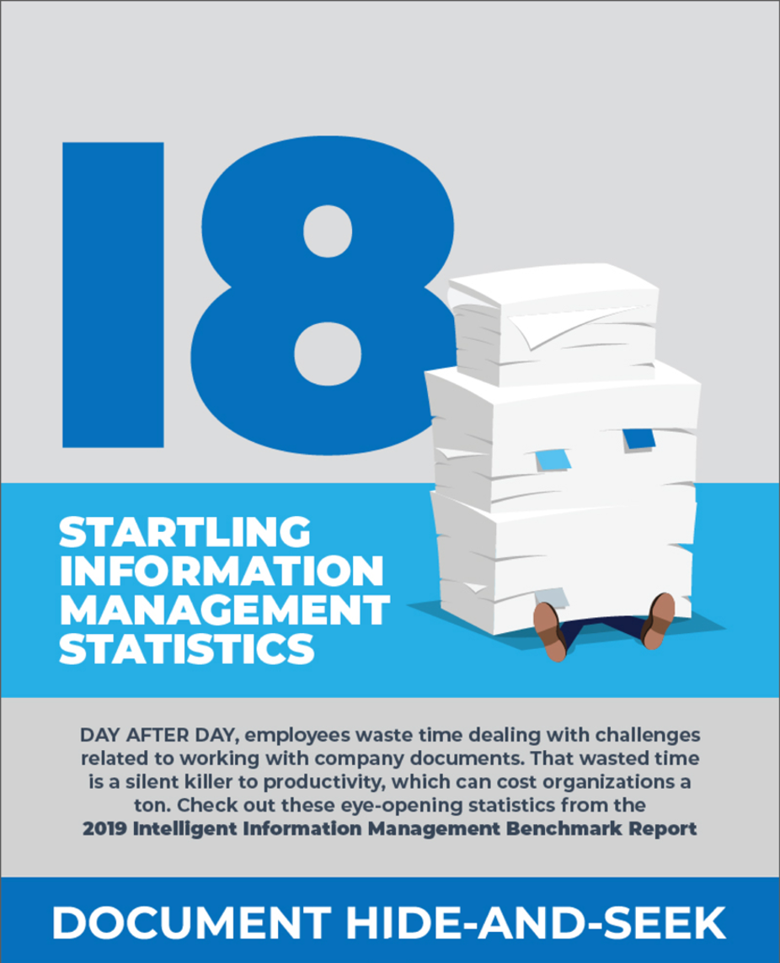
Wasted time dealing with business documents is a silent killer of productivity and can cost your business a ton. Download the Stats from the 2019 Intelligent Information Management Business Report. https://bit.ly/2PXqmmG #CIMSGlobalTechnologysolutions #cimsgts #timemanagement #documentsolutions #businesssolutions #workflowmanagement #databasedevelopment #collaboration #freemyoffice #productivity #virtualoffice @RonCasto
Posted 8/27

Slide 5
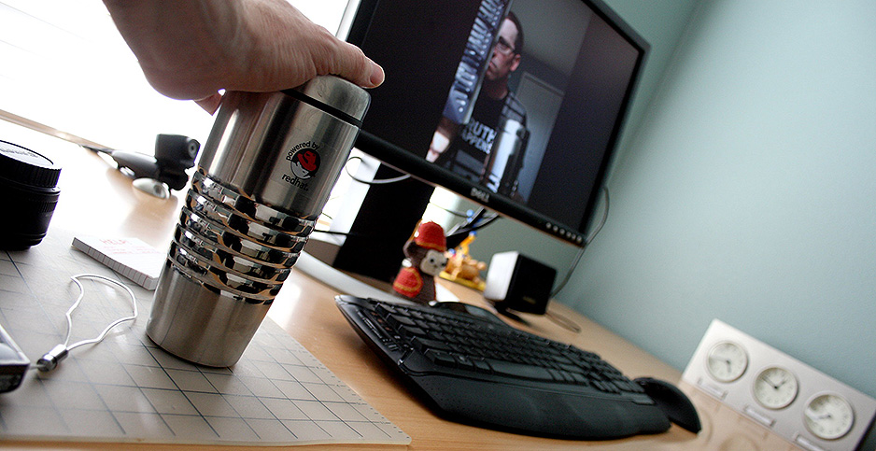
Telework is not only the wave of the pandemic, but the wave of the future. Teleworking just might be here to stay. Is your business ready?
https://bit.ly/3hfIQuS
#documentsolutions #processautomation #electronicsignage #b2b #bbb #rpa #RoboticProcessAutomation @RonCasto
Posted 9/4
Article Link:
PANDEMIC: Telework could outlive the virus, lowering emissions

Slide 6

Resilient businesses shift with the times. is it time to start re-imagining a world without printers? Contact CIMS and let's see what that looks like for your company.
#cimsglobaltechnologysolutions #cimsgts #kodak #printingsolutions #digitalsignate #electronicdocuments #resilientbusiness #wastemanagement #solutions #business #pandemicproof #timemanagement ##kofax #canon #panasonic #kodak #Microsoft
Scheduled 9/9
Article Link:
Will the pandemic spell the end of the printer? - CIO Dive
Will the pandemic spell the end of the printer? CIO Dive
https://www.ciodive.com/news/printer-use-remote-work-coronavirus/583261/

Slide 7

Match the Speed of Business with Enterprise Document Management Solutions. Reduce cost and save time with a single source of scalable, configurable workflows that help streamline collaboration with all internal departments for a more productive workforce. Call CIMS today for your free consultation.
#CIMSGlobalTechnologySolutions #Freethehumans #business #smallbusiness #bigbusiness #enterprisedata #collaboration #data
#technology #automatedprocessmanagement #robotics #documentsolutions #businesstobusiness
#eliminatepaper #wastemanagement #solutions #business #pandemicproof #timemanagement
#documentsolutions #businesssolutions #workflowmanagement #databasedevelopment
#businesstobusiness #b2b #bbb #mfiles #kofax #canon #panasonic #kodak #Microsoft
Scheduled 9/11
Article Link:
Will the pandemic spell the end of the printer? - CIO Dive
Will the pandemic spell the end of the printer? CIO Dive
https://www.ciodive.com/news/printer-use-remote-work-coronavirus/583261/

